Slide 1
Online Examination Portal
Mini Project by – Pradyot Itkurkar

Slide 2
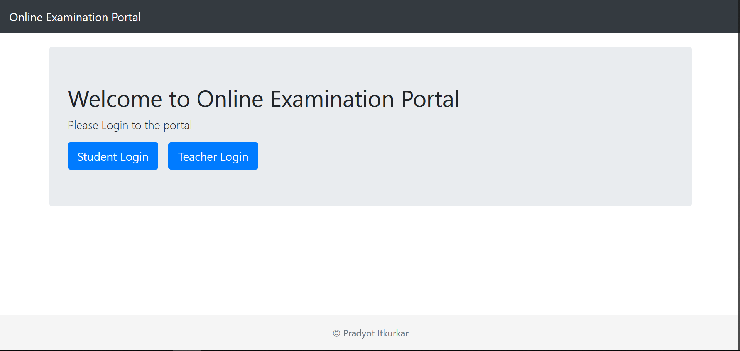
Screenshot – Home Page

Slide 3
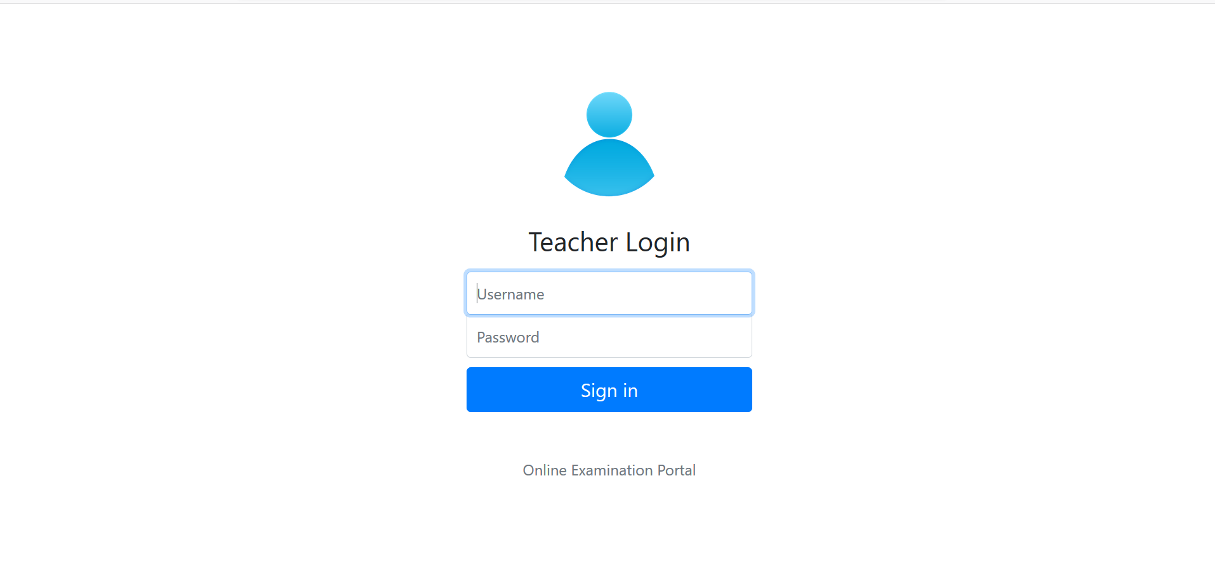
Screenshot – Login Page

Slide 4
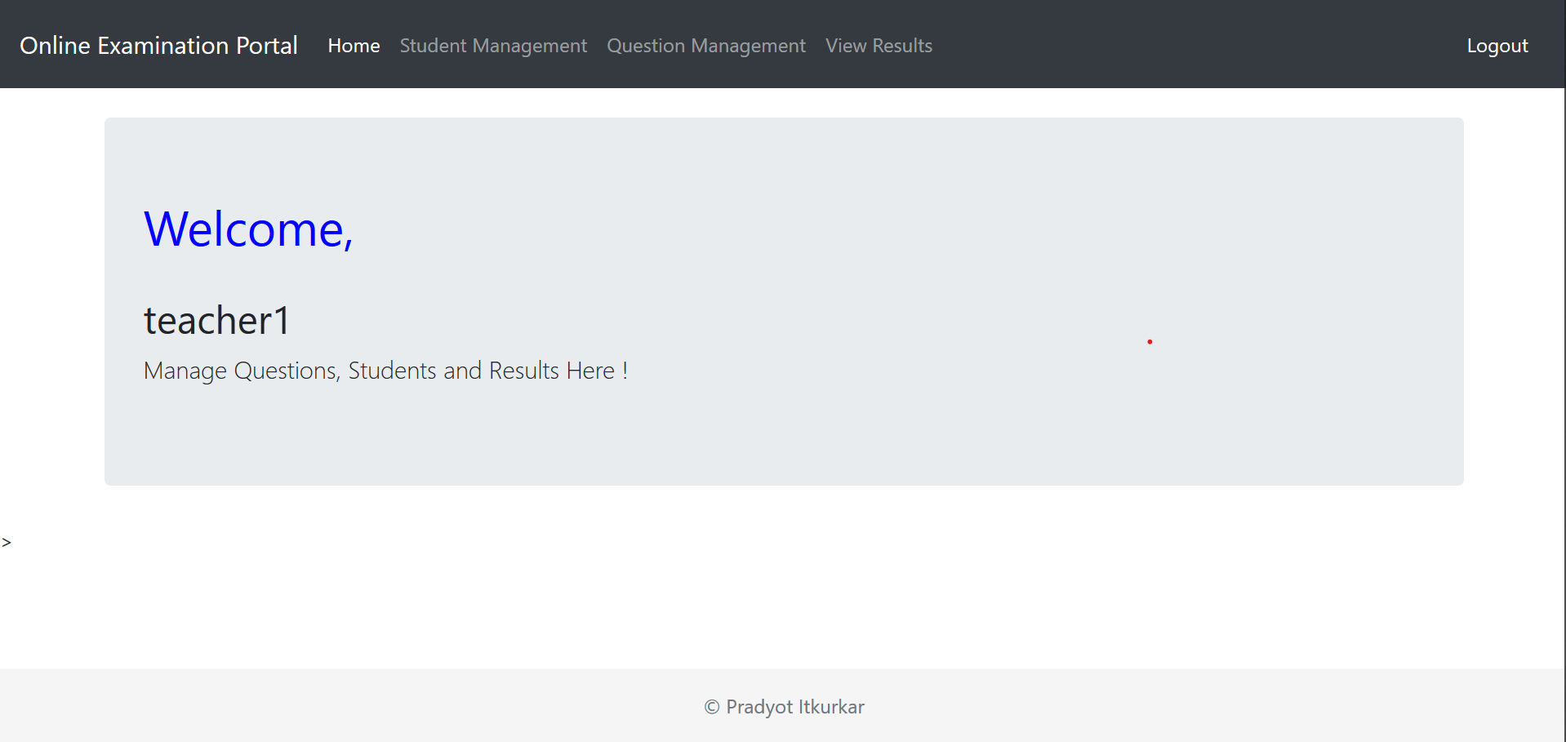
Screenshot – Teacher Home Page

Slide 5
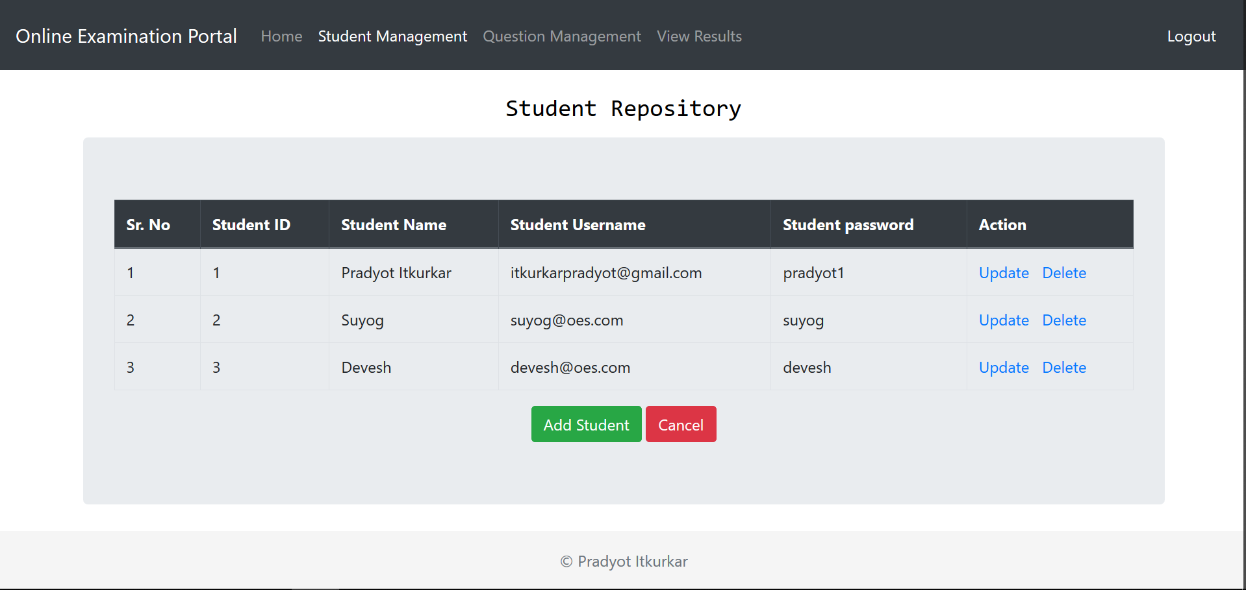
Screenshot – Student Repo

Slide 6
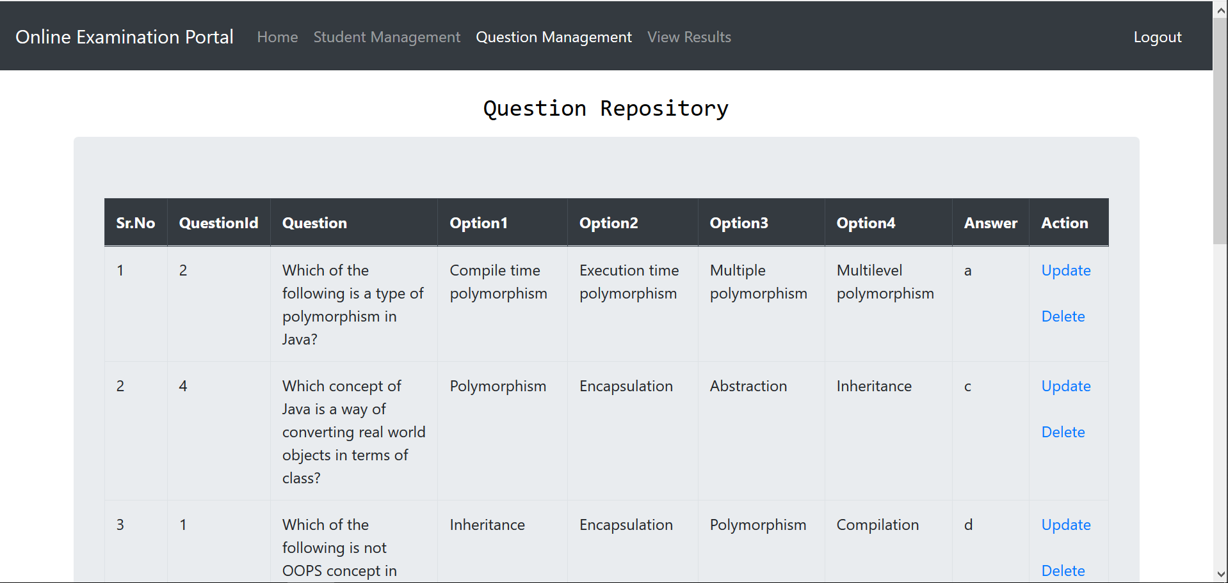
Screenshot – Question Repo

Slide 7
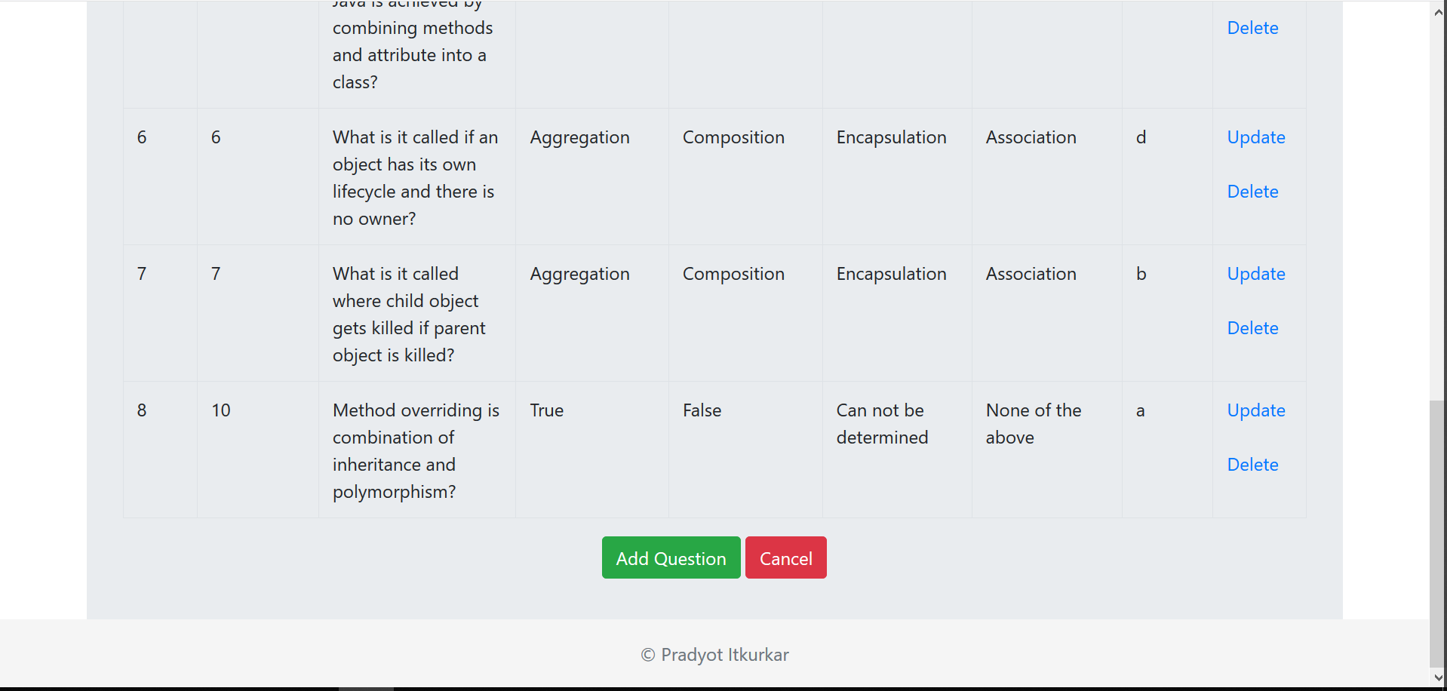
Screenshot – Question Repo

Slide 8
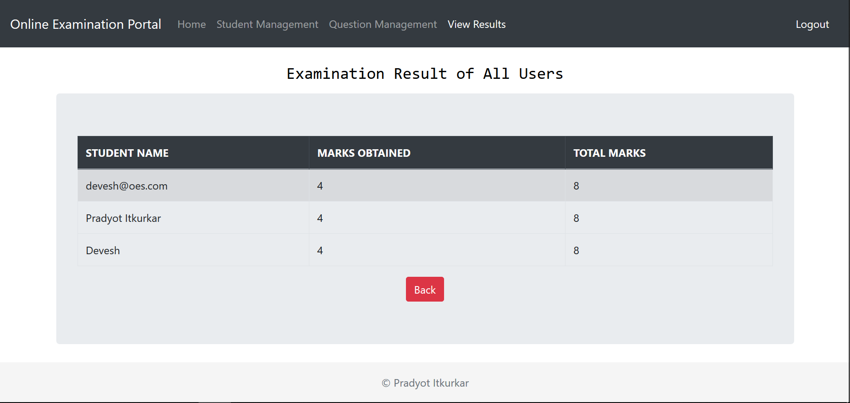
Screenshot – Result

Slide 9
Screenshot – Result

Slide 10
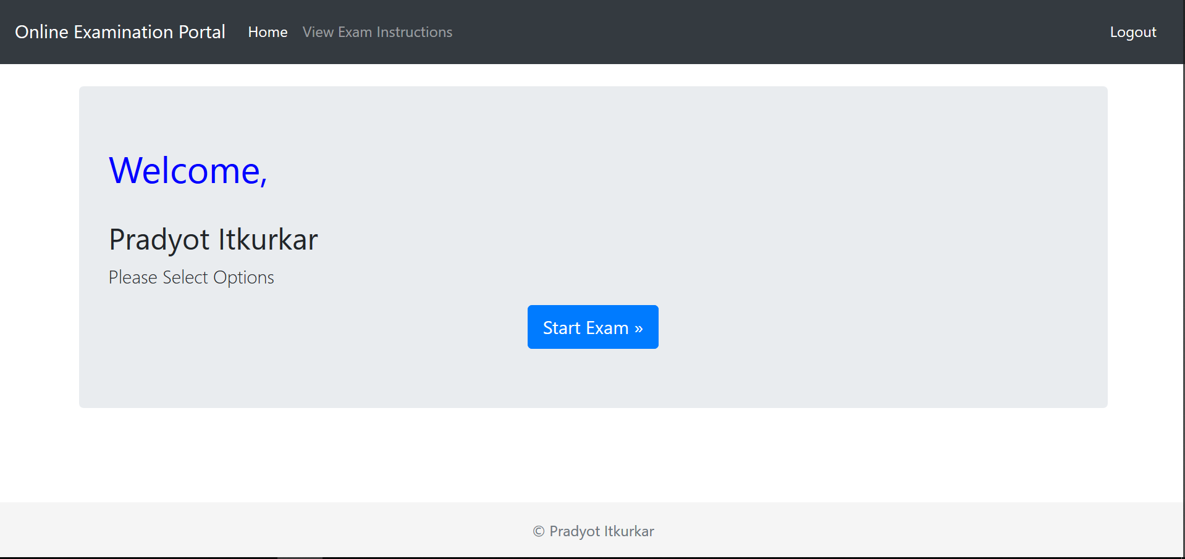
Screenshot – Student Home

Slide 11
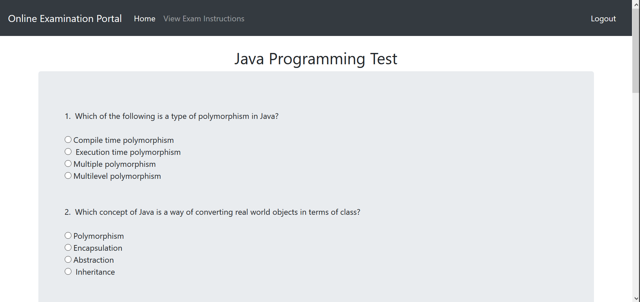
Screenshot – Exam

Slide 12
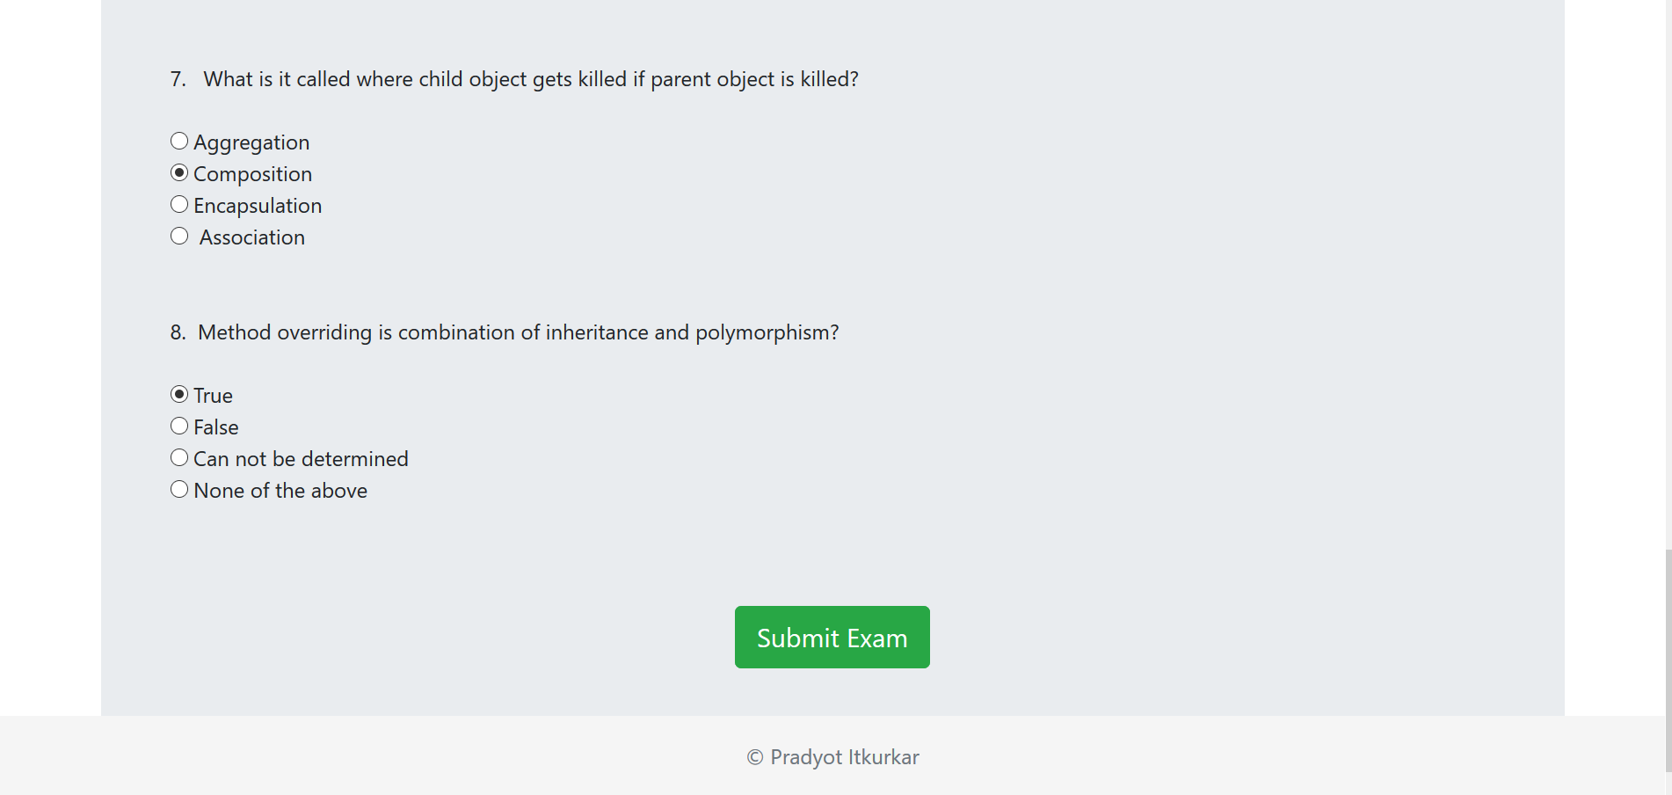
Screenshot – Exam

Slide 13
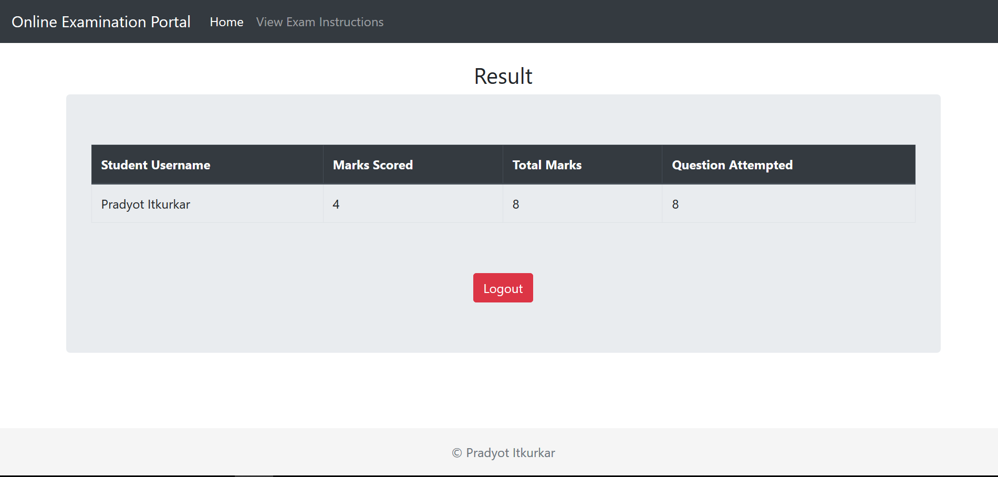
Screenshot – Result

Slide 14
Important file description
1. Result Servlet – This servlet calculates the result after exam and stores it into result table in db. (Package = com.miniproject.controllers.ResultServlet)
2. ViewStudentMarks.java – displays all the results for exam in teacher management.(Package = com.miniproject.controllers.ViewStudentMarks)
3. Exam.jsp – Main examination page, where questions are fetched from question table. (Package = Webcontent -> Exam.jsp).
4.StudentRepository.jsp - This jsp page holds code for student repository which deals with CRUD ops for students. (Package = Webcontent -> StudentRepository.jsp).
5.QuestionRepository.jsp - This jsp page holds code for question repository which deals with CRUD ops for questions. (Package = Webcontent -> QuestionRepository.jsp).
6.ExamResults.jsp - All examination results displayed in teacher panel. (Package = Webcontent -> ExamResult.jsp).

